Slide 2
Oral Statements
Oral statements or discussion during this Pre-Submittal Meeting will not be binding, nor will they change or affect the RFQ or the terms or conditions of the contract. Changes, if any will be addressed in writing only via an Addendum.

Slide 3
Presentation Overview
Objective
Requirements and Restrictions
Submission Restrictions
Selection Process
Evaluation Criteria
SMWVB
Submissions
Key Dates
Submittal Deadline
Negotiations
Communication Reminders
Questions
Project Matrix
Project Charters
Technical Information

Slide 4
Objective
Provide professional engineering design services, as well as all associated engineering services necessary to advance sanitary sewer overflow and reduction program projects
Includes both bid and construction phase services
The projects included in this RFQ represent Condition Project Packages required to meet Consent Decree (CD) requirements
SAWS anticipates awarding a contract to more than one Consultant.

Slide 5
Requirements and Restrictions – Additional Requirements
Will perform all project-related functions utilizing Contract and Project Management System (CPMS)
Including adhering to specified service levels for processing change orders, RFIs, RFPs, and scratch sheets
Familiar with the consent decree
Certain actions to rehabilitate the wastewater collection system to reduce SSOs
Meet all milestones and adhere to the project schedule as published

Slide 6
Requirements and Restrictions – Submission Restrictions
SSORP Program Manager, HDR, may not submit for this RFQ
Sub-consultants are eligible to service as a sub or prime consultant
Please refer to Section II, D. Submission Restrictions, 1 in the RFQ

Slide 7
Selection Process
SOQs reviewed for responsiveness
Technical Evaluation Committee scores qualification statements based on evaluation criteria published in the RFQ
Interviews held, if necessary
Selection Committee reviews scores and recommends firms
Good Faith Effort Plan will be evaluated and scored
Negotiation with selected consultants
Board Award

Slide 8
Evaluation Criteria
CRITERIA | MAX POINTS
Team Experience and Qualifications | 20
Similar Projects and Project Performance | 25
Project Approach | 30
Quality Management/Quality Control | 10
Small, Minority, Woman, and Veteran-owned (SMWVB) Business Participation | 15
Total | 100

Slide 9
Evaluation Criteria – Team Experience and Qualifications (20 points)
Organizational Chart – Page Limit 1
All key team members (including key sub-consultants)
Project Manager, Cost Estimator, Quality Assurance and Quality Control Review Lead and Reviewers, and all Design Team Leads required
Role and percentage of time each key team member will be committed
Ensure sub-consultants match those listed on the Good Faith Effort Plan
Resumes for Key Personnel Only – Page Limit 8
Project Manager, Cost Estimator, Quality Assurance and Quality Control Review Lead and Reviewer, and Design Team Leads (no more than 3 Design Team Leads)
Resumes should not include exhaustive list of projects, but rather projects relevant to scope of services in the RFQ and their role in that project
Describe firm’s most relevant experience using Subconsultant Table
No additional narrative required

Slide 10
Evaluation Criteria – Similar Projects and Past Performance (25 points)
Complete Project Table for 5 Relevant Projects, of Similar Size and Scope to projects in the RFQ (5 page limit)
Similar projects are wastewater/ SSO projects of similar scope, pipe diameter and contract value
Identify key personnel and their roles and responsibilities for at least 3 of the 5 projects
A minimum of 3 projects must be performed by Respondent
Ensure contact information for references is correct and valid
Complete OPCC Table
5 Relevant Projects and 3 additional projects, as it relates to the accuracy of OPCC and change orders
No additional narrative required

Slide 11
Evaluation Criteria – Project Approach (30 points)
This criteria is weighted the heaviest
Narrative format limited to a 6 page response for 3 questions to include:
Describe team’s approach to complete the project managing risk between design related issues, constructability and budget
Respondent should select 1 of the projects identified and use it to address unique circumstances
Identify team’s suggested alternative innovative approaches to accomplishing the scope of services identified
Describe team’s approach to preparing deliverables to meet deadlines
Include schedule risks and mitigation measures, schedule recovery approach and other issues relative to schedule maintenance on similar projects

Slide 12
Evaluation Criteria – Quality Management/Quality Control Plan (10 points)
Narrative format limited to 2 pages
Includes:
Overview of the QCP process and schedule
Plan identifying, tracking and resolving design issues
Describe how independent quality review team will confirm documents
Role compared to SAWS’ role
Approach to becoming familiar with local construction practices and requirements
Outline how accuracy and completeness of independent cost estimates are derived for each phase of design

Slide 13
Submissions
Submit hard copies (1 original and 8 copies)
Include a USB flash drive/CD of the original proposal (all pages)
Reference the RFQ on additional required items
Must submit using Evaluation Criteria Forms where indicated
Use 8 ½ x 11 portrait format
Thoroughly read the RFQ to ensure Respondent is familiar with scope
Be very specific and avoid “boiler plate” responses for narrative responses
Utilize the Submittal Response Checklist
Contact the SMWVB Program Manager for assistance, if necessary
Perform QA/QC on proposal prior to submitting

Slide 14
Dates
Questions Due
March 25 by 10:00 AM
Answers Posted by SAWS
March 27 by
4:00 PM
Start Work
July 2020
SOQs Due
April 6 by
10:00 AM
Interview with Consultants
(if necessary)
May 2020
SAWS Board Award
July 2020
*The dates listed above are subject to change without notice

Slide 15
Submittal Deadline
Solicitation number, solicitation name, date and time of the deadline should be clearly identified on the outside of the package
Deliver to 2800 U.S. Highway 281 North, Customer Service Building
Deliver to Counter Services
SAWS recommends submitting proposals at least 2 hours prior to the deadline
Make arrangements early if mailing a response
Late responses will not be accepted and will be returned unopened

Slide 16
Negotiations
Must be completed within 15 calendar days from receipt of Respondent’s Selection Letter
If an agreement cannot be reached within the time frame, SAWS will formally cease negotiations and begin negotiations with the next most qualified firm

Slide 17
Communication Reminders
There should not be any communication regarding this solicitation with the following:
SAWS Project Manager
SAWS Technical Representative
Any other SAWS staff, managers, directors, or VPs
City Council member or staff
SAWS Board of Trustees
This includes phone calls, emails, letters, or any direct or indirect discussion of the RFQ
This is in place from release of the RFQ to Board Award

Slide 18
Questions
Must be submitted in writing by March 25, 2020 by 10:00 A.M. via e-mail to:
Florinda Gonzales
Contract Administration Department
San Antonio Water System
florinda.gonzales@saws.org

Slide 19
Small, Minority, Woman, and Veteran-Owned Businesses (SMWVB Participation) Scoring:
M/WBE Scoring Method: Up to 10 Points (By percentage) 40.00% M/WBE Goal
a) M/WBE Scoring Method: Up to 10 Points (By percentage) 40.00% M/WBE Goal
• M/WBE Participation Percentage between 1% and 9.99%: 2 Points
• M/WBE Participation Percentage between 10% and 19.99%: 4 Points
• M/WBE Participation Percentage between 20% and 29.99%: 6 Points
• M/WBE Participation Percentage between 30% and 39.99%: 8 Points
• M/WBE Participation Percentage meeting or exceeding 40.00%: 10 Points
b) Utilization of a local SMWB-certified Engineering Firm that has not worked with SAWS as a prime consultant in the past five years, for 10% of Sewer Design Services: 5 Points

Slide 20
Small, Minority, Woman, and Veteran-Owned Businesses (SMWVB Participation) Requirements:
Payments made to subconsultants, subcontractors, and suppliers (SMWVBs and Non-SMWVBS) will be reported using SAWS’ Subcontractor Payment and Utilization Reporting (S.P.U.R.) System. This is a contractual requirement.
All firms listed in the organizational chart must also be listed in the Good Faith Effort Plan.
SMWVB-certified firms need to have a local-area office, must be “SBE” at minimum, and need to be certified through the SCTRCA or Texas HUB.

Slide 21
Questions related to the SMWVB Program, completion of the Good Faith Effort Plan(GFEP), or SMWB scoring may be directed to the SMWVB Program Manager, up until the RFQ is due.
Contact information:
Marisol V. Robles
SMWVB Program Manager
Email: Marisol.Robles@saws.org
Telephone: 210-233-3420

Slide 22
Project Matrix
Project Name | Central Sewershed Package 14 | 2020 CMOM Package 1 | 2020 CMOM Package 2
Project ID | Pro-11409 | Pro-11410 | Pro-11411
Design Schedule | August 2020 – June 2021 | August 2020 – July 2021 | August 2020 – February 2021
Est. design Cost | $1,620,000.00 | $1,200,000.00 | $300,000.00
8"-21" diameter pipe | X | X | X
24"+ diameter pipe | X | X
Description | This project will rehabilitate approximately 435 feet of 8-inch pipe, 34 feet of 24-inch pipe, 113 feet of 33-inch pipe, 283 feet of 42-inch pipe, 3,378 feet of 48-inch pipe, 1,803 feet of 54-inch pipe, and 2,761 feet of 60-inch pipe via CIPP method. 36 pipe segments have been identified in this package and are located throughout the city. CIPP is the suggested remedial method due to pipe condition. | This project will rehabilitate approximately 88 feet of 8-inch pipe, 1,604 feet of 24-inch pipe, 360 feet of 27-inch pipe, 328 feet of 33-inch pipe, 1,736 feet of 36-inch pipe, 1,453 feet of 42-inch pipe, 1,093 feet of 48-inch pipe, 993 feet of 54-inch pipe, and 698 feet of 60-inch pipe via CIPP method. 29 pipe segments have been identified in this package and are located throughout the city under major roads. The suggested remedial methods were chosen due to pipe condition. | This project will rehabilitate approximately 1,461 feet of 8-inch pipe, 694 feet of 10-inch pipe, 288 feet of 12-inch pipe, 1,259 feet of 15-inch pipe, and 1,038 feet of 20-inch pipe via CIPP method. This project will rehabilitate approximately 123 feet of 8-inch pipe via Open Cut method. 16 pipe segments have been identified in this package and are located throughout the city. CIPP and Open Cut are the suggested remedial methods due to pipe condition.

Slide 23
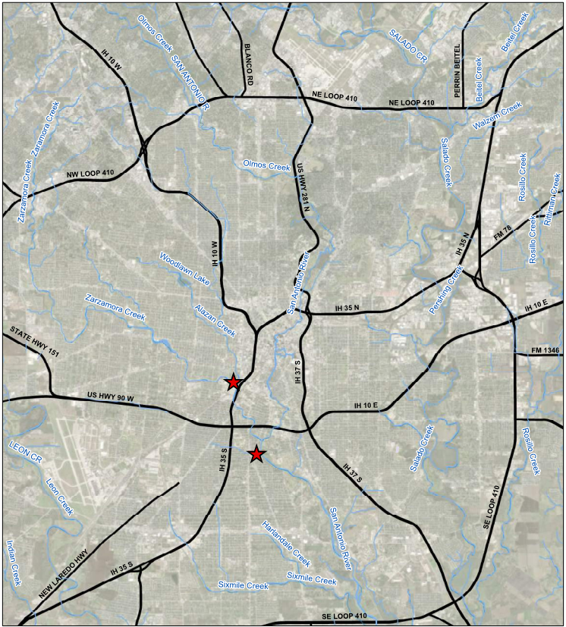
Central Sewershed Package 14
Location:
2 locations within the Central Basin
Pipe Diameter:
8-inch thru 60-inch
Project Length:
Approximately 8,807 feet
Rehab Method:
CIPP
Estimated Construction Cost:
Not to exceed $5,400,000
Notes:
This project will rehabilitate approximately 8,807 LF of pipe using CIPP method; 435 LF of 8-inch pipe, 34 LF of 24-inch pipe, 113 LF of 33-inch pipe, 283 LF of 42-inch pipe, 3,378 LF of 48-inch pipe, 1,803 LF of 54-inch pipe, and 2,761 LF of 60-inch pipe. Both locations are near creeks and will include large diameter bypass.

Slide 24
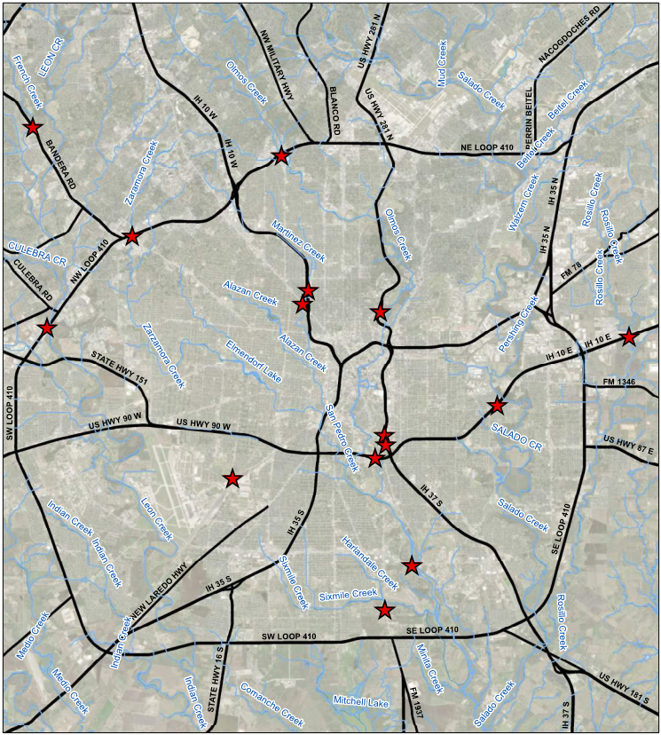
2020 CMOM Package 1
Location:
Multiple locations throughout the city, under major roads.
Pipe Diameter:
8-inch thru 60-inch
Project Length:
Approximately 8,353 feet
Rehab Method:
CIPP
Estimated Construction Cost:
Not to exceed $4,010,000
Notes:
This project will rehabilitate approximately 8,353 LF of pipe using CIPP method; 88 LF of 8-inch pipe, 1604 LF of 24-inch pipe, 360 LF of 27-inch pipe, 328 LF of 33-inch pipe, 1,736 LF of 36-inch pipe, 1,453 LF of 42-inch pipe, 1,093 LF of 48-inch pipe, 993 LF of 54-inch pipe, and 698 LF of 60-inch pipe using CIPP method. All the Locations are crossing under major roads. There are several locations where work will be done near a creek, or in the 100 year floodplain, and one location under a RR.

Slide 25
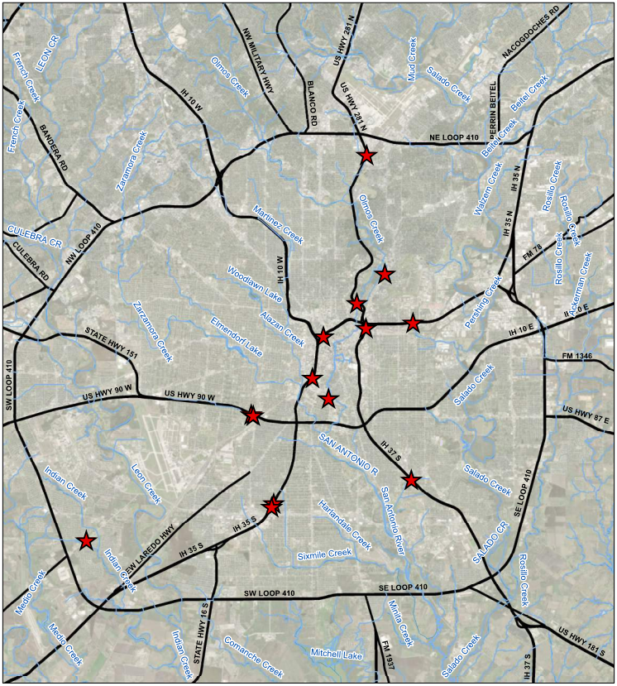
2020 CMOM Package 2
Location:
Multiple locations throughout the city, under major roads.
Pipe Diameter:
8-inch thru 20-inch
Project Length:
Approximately 4,863 feet
Rehab Method:
CIPP, and Open Cut
Estimated Construction Cost:
Not to exceed $1,000,000
Notes:
This project will rehabilitate approximately 4,740 LF of pipe using CIPP method, and 123 LF of pipe will be removed and replaced via Open Cut; 1,461 LF of 8-inch pipe, 694 LF of 10-inch pipe, 288 LF of 12-inch pipe, 1259 LF of 15-inch pipe, 1,038 LF of 20-inch pipe using CIPP method, and 123 LF of 8-inch pipe using Open Cut. All the locations are crossing under major roads. There are locations where work will be done near a creek, or in the 100 year floodplain. One location is in a major CPS facility, and two locations are near CoSA parks one being Brackenridge Golf course.

Slide 26
Cost Estimates – Design Phase
Consultant must develop opinions of probable construction costs (OPCC) for all phases of each project as per the recommendations of AACE International (formerly the Association for the Advancement of Cost Engineering) as described in AACE’s document 56R-08: Cost Estimate Classification System – as Applied for the Building and General Construction Industries

Slide 27
Cost Estimates – Design Phase
Consultants to develop OPCCs for each phase as follows:
Design Phase | Estimate Class | Expected Accuracy Range
30% Design | Class 3 | L: -5% to -15% H: +10% to +20%
60% Design | Class 2 | L: -5% to -10% H: +5% to +15%
90% Design | Class 1 | L: -3% to -5% H: +3% to +10%
Bid Documents | Class 1 | L: -3% to -5% H: +3% to +10%

Slide 28
Cost Estimates – Construction Phase
Consultant must provide independent cost estimates based on the RS Means method of cost estimating by using the most current RS Means publication, with the appropriate adjustments for the location cost factors and the applicable overhead and profit percentages. These cost estimates are due on or before a RFP is requested from a SAWS contractor.

Slide 29
Quality Management Plan
QMP
Consultant will be required to develop a QMP
QMP reviews to be performed by staff not involved in day to day
QMP reviews are at different intervals during the design phases
Constructability reviews with experienced personnel are required in the QMP to ensure project is buildable
A QMP Certification Letter will be required
Notes:
An example of the QMP Certification Letter is provided in the RFQ

Slide 30
New TCEQ Requirements
Chapter 217.6 Transmittal Letter
Ensures compliance with §217.6(c)
Requests any variances from Chapter 217 and provides technical justification for said variance
Discloses any innovative or nonconforming technologies in use
Required to be signed and sealed
Notes:
An example of the Chapter 217.6 Summary Transmittal Letter is provided in the RFQ

Slide 31
Key Considerations
Schedule
Methods of construction
Coordination with other agencies (e.g., COSA, Bexar County, TxDOT, USACE, TCEQ, VIA etc.)
Easements and ROW
Identification of utilities (above and below ground)
Environmental Site Assessment
Surveys and topographic information
Access points for construction and adequacy of easements
Bypass plans and traffic control
Plans, Specifications, and Cost Estimates

Slide 32
Key Considerations
Confirm all requirements met of each section in the RFQ
Use relevant experience
Both Resumes and Past Performance
Become familiar with Project chosen for Project Approach
Avoid using “Cookie Cutter” submissions

